Slide 1
Coal mining in the Hunter Valley
Educational Resource
People and Place I Coal and Community Project
Coal Mining Domestic use and bi products

Slide 2
What are the uses of coal?
There are two major types of coal, coking coal and thermal (or steaming) coal.
Coking coal is used to make coke, which is an ingredient in steel production. The steel is used in millions of items such as cars, trucks, fire engines, refrigerators and bridges, such as the Story Bridge and Sydney Harbour Bridge.
Thermal coal is used to provide heat energy. Its main use is in power stations where the heat is used to make steam, used to spin turbines and generate electricity.
Electricity is required to operate all electrical appliances such as fridges, hairdryers and mobile devices.
Coal is also an important ingredient in plastics, explosives, dyes, pitch, ammonia, medicines, aspirin, soap, disinfectant, detergents, nylons, cosmetics, synthetic rubber, fertilizers, cement, bricks, baking power, batteries, some linoleum, mothballs, sugar substitutes, perfumes and tiles.

Slide 3
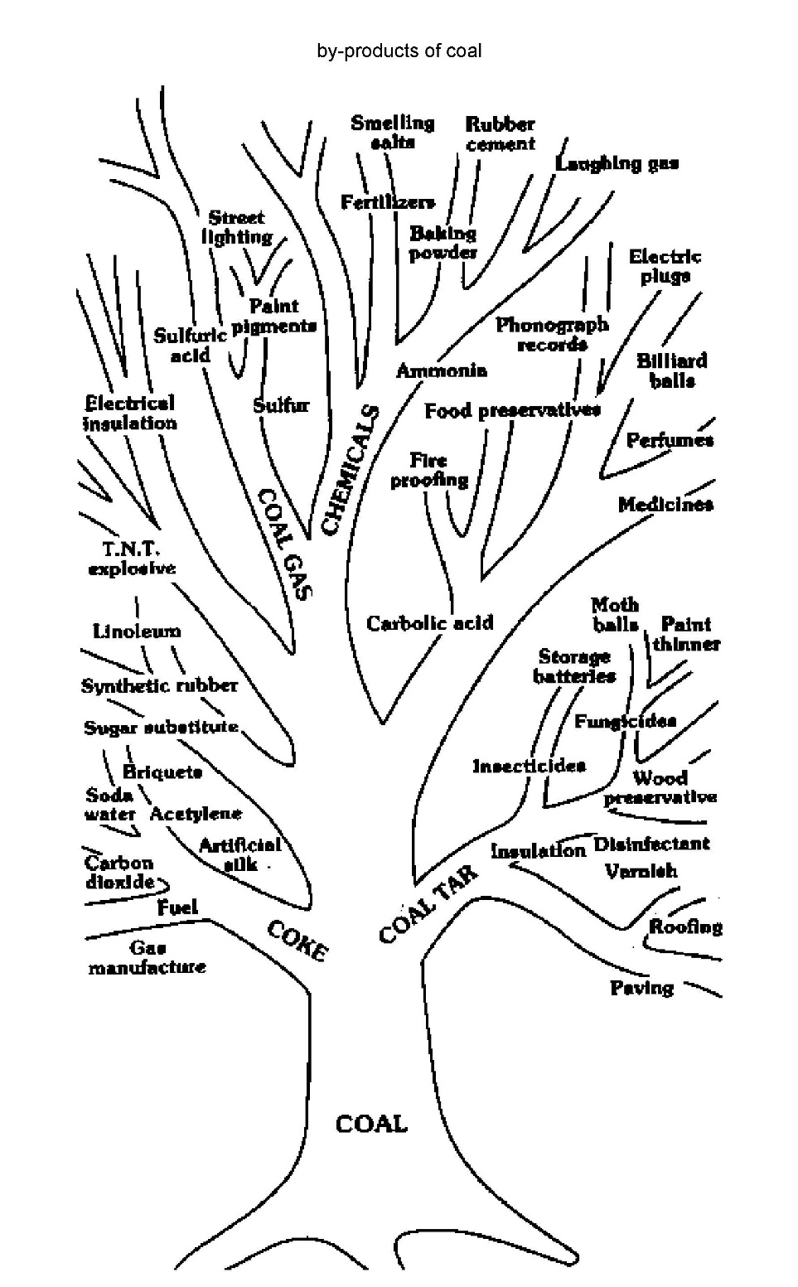

Slide 4
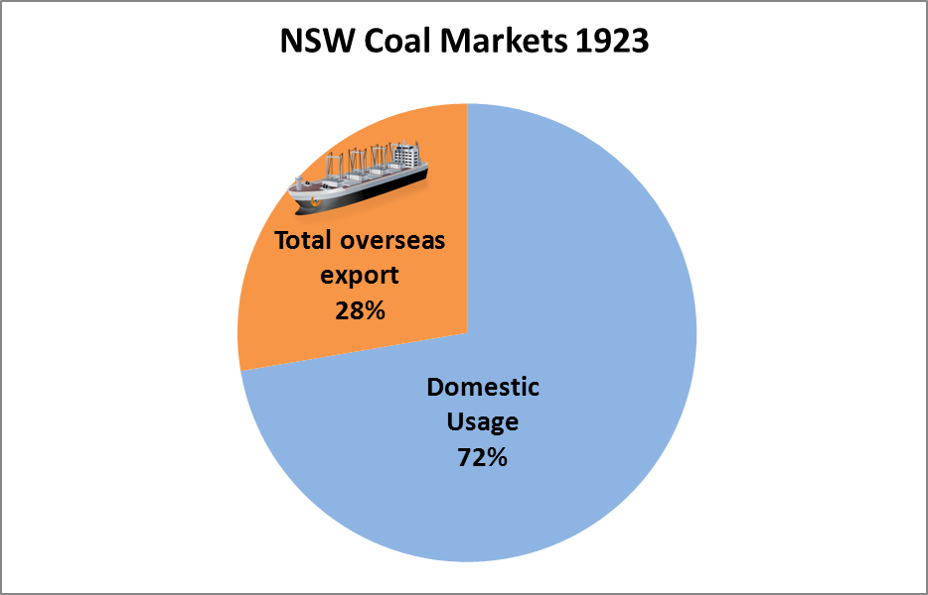
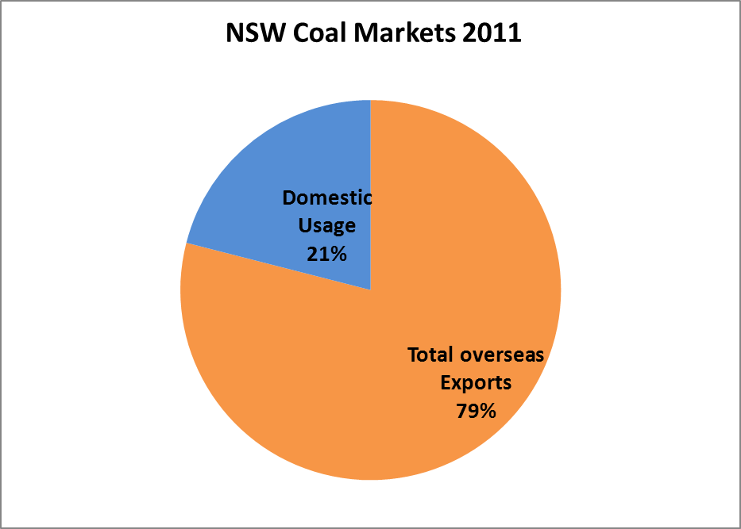
Domestic use of coal & exports

Slide 5
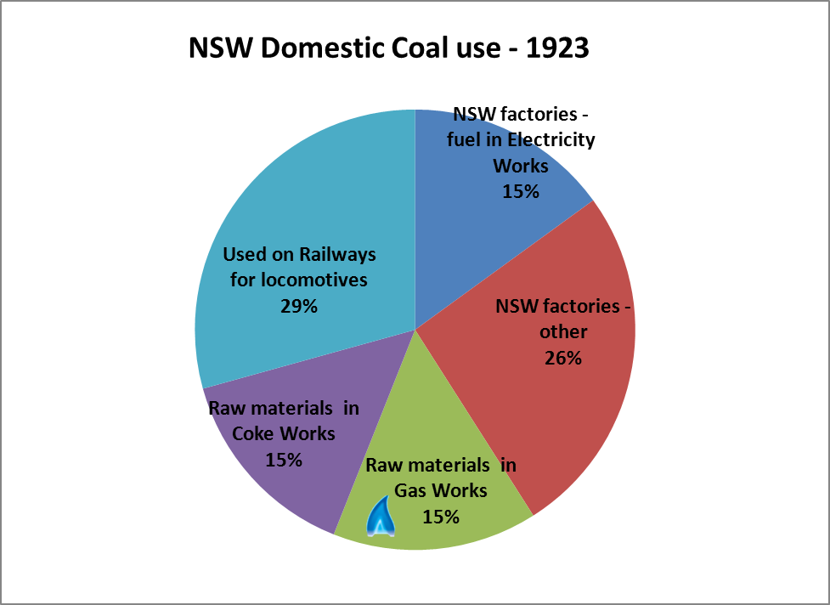
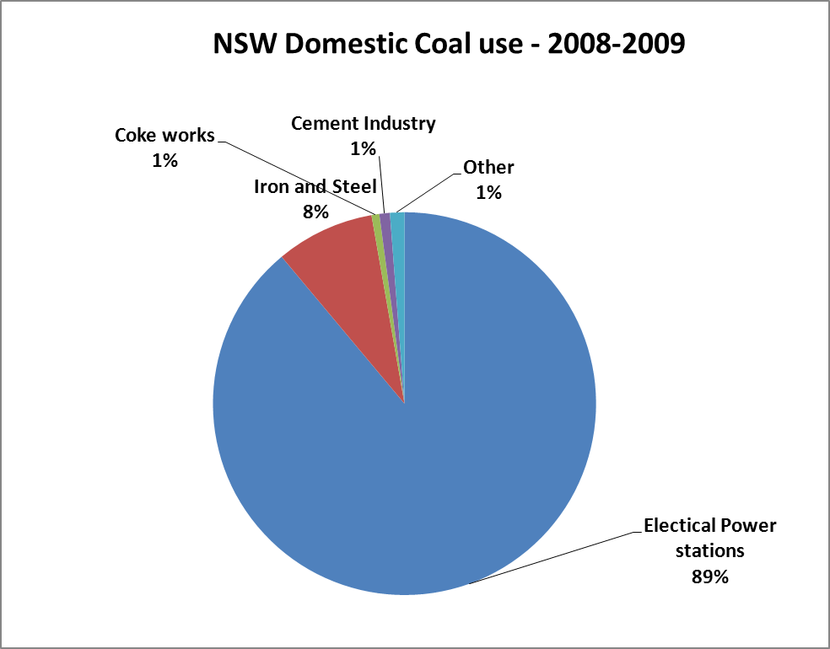
Domestic use of coal
1923 & 2008-2009

Slide 6
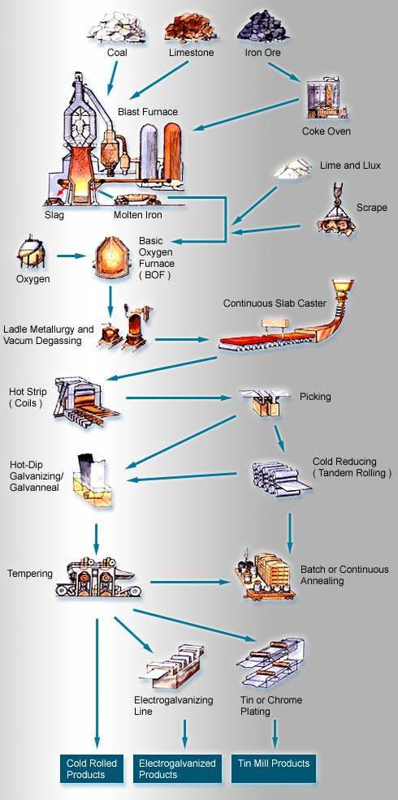
Steel production

Slide 7
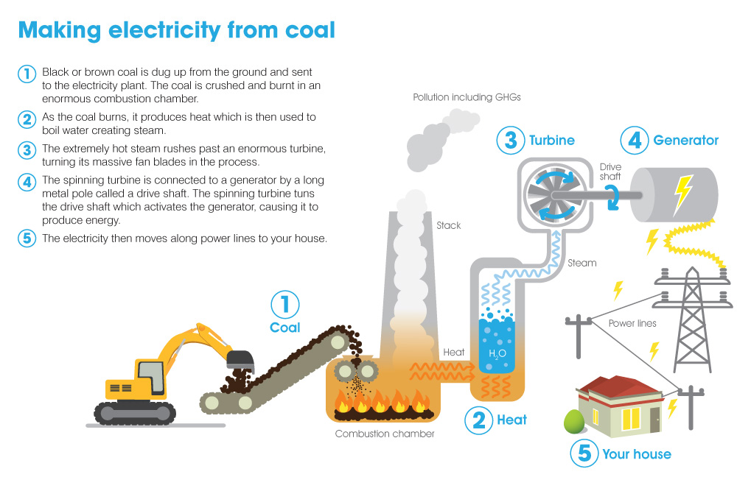
http://www.transport.vic.gov.au/projects/ev-trial/ev-school/teachers/classroom

Slide 9
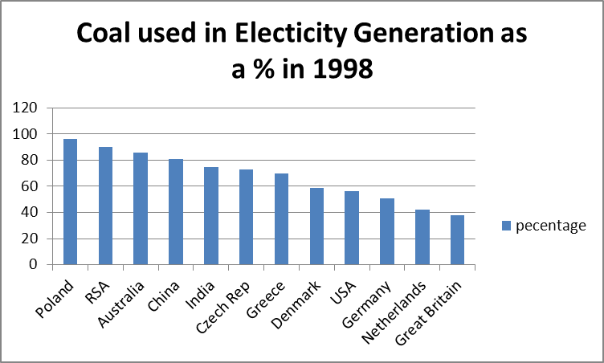

Slide 11
