Slide 1
Coal mining in the Hunter Valley
Educational Resource
People and Place I Coal and Community Project
Coal exports and imported goods

Slide 2
International Coal exports from nsw 1886
Other 51 %
Fiji
New Caledonia
Sandwich Islands - Hawaii
Mauritius Peru
Mexico
Ceylon
South Sea Islands
Kaiser Wilhelm's Land
(SE Papua New Guinea)
Panama
Cape of Good Hope

Slide 3
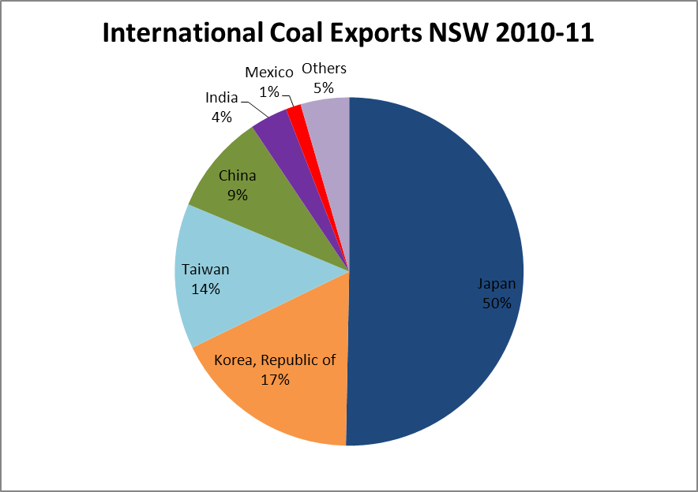
International Coal exports from nsw 2001-02 & 2010-11

Slide 4
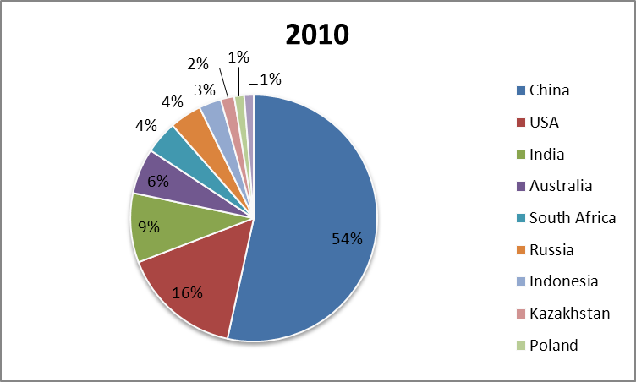
Top ten word producers of coal

Slide 5
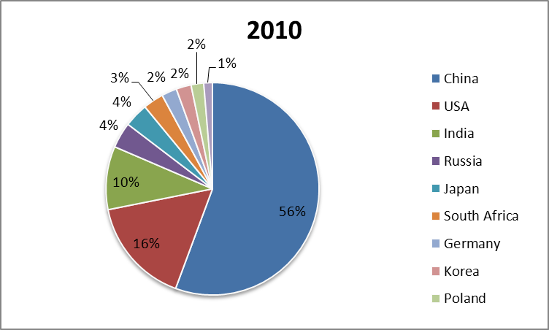
Top ten consumers of coal

Slide 6
Exports/Imports from china in 2007
Exports
Copper ores | $504 million
Wool | 235 million
Coal | 131 million
Aluminium | 129 million
Non-ferrous metal waste | 118 millon
Imports
Computers | $2696 million
Telecommunications equipment | $1729 million
Toys, games & Sporting goods | $640 million
Sound or video recorders | $582 million
Computer parts | 537 million

Slide 7
Exports/Imports from Japan 2012
Exports
Coal | $14941 million
Iron ores & concentrates | $ 9042 million
Copper ores & concentrates | $ 1551 million
Beef | $ 1515 million
Imports
Passenger motor vehicles | $7302 million
Goods Vehicles | $1538 million
Refined petroleum | $1492 million
Civil engineering equipment & parts | $ 963 million

Slide 8
Exports/Imports from Mexico 2012
Exports
Coal | $518 million
Medicament (including veterinary) | $ 92 million
Aluminium | $ 63 million
Plastic plates, sheets & Film | $ 24 million
Imports
Telecom equipment & Parts | $295 million
Lead ores & concentrates | $277 million
Vehicle parts & accessories | $152 million
Passenger motor vehicles | $150 million

Slide 9
Imports from Republic of Korea 2012
Exports
Iron ores & concentrates | $5453 million
Coal | $5425 million
Crude petroleum | $1389 milloin
Beef | $ 646 million
Imports
Refined petroleum | $2,676 million
Passenger motor vehicles | $2,047 million
Civil engineering equipment &parts | $1,292 million
Telecom equipment & parts | $ 266 million

Slide 10
Exports/Imports from Taiwan 2012
Exports
Coal | $2982 million
Iron ores & concentrates | $1457 million
Crude petroleum | $ 534 million
Medicaments (including veterinary)\ | $ 408 million
Imports
Telecom equipment & parts | $489 million
Refined petroleum | $140 million
Motorcycles & cycles | $126 million
Computers | $118 million

Slide 11
Exports/Imports from India 2012
Exports
Coal | $5347 million
Gold | $2975 million
Copper ores & concentrates | $1348 million
Vegetables | $ 414 million
Imports
Pearls & gems | $171 million
Passenger motor vehicles | $171 million
Medicaments (including veterinary) | $168 million
Tubes & pipes of iron or steel | $168 million

