Slide 1
Coal mining in the Hunter Valley
Educational Resource
People and Place I Coal and Community Project
What is Coal

Slide 2
Contents
What is mining
What is coal
How is coal formed
Types of coal
Coal measures seams and fields
Where is coal found

Slide 3
What is mining
Mining is the process of taking minerals from the earth.
A mineral substance is almost any non living thing that is found in the earth, for example:
coal
Sand
Oil
Natural gas
Iron
Copper
Silver
Salt
gold
uranium
phosphate
gravel
diamonds and gems

Slide 4
What is coal?
Coal is an organic material.
It is the fossilized remains of plants that
lived 200 million years ago.
Coal in the Hunter Valley is mainly from
the Permian period
The main elements in coal are:
carbon
hydrogen
Oxygen
There are small amounts of sulphur and nitrogen in coal. The amount and combination of these elements in coal determine the amount of heat, pressure and water are in the coal.

Slide 5
How coal is formed

Slide 6
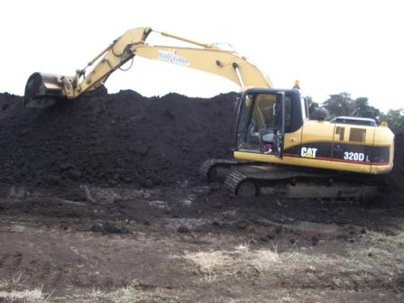
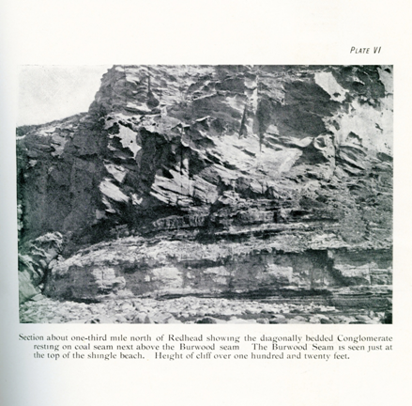
How coal was formed
Belmont wetlands (photographed by Lindsay Sullivan)
Peat Extraction at BioGro's Western Victoria site http://biogro.com.au/index.php?page=broadacre

Slide 7
Types of coal
Anthracite (hard black coal) – This coal is dense. It is made up of under 10% volatile mater. It is kindled slowly and requires a strong draft. The flame is short and colourless and it produces little smoke.
Bituminous – (black coal) This is used for coking purposes. Coking coal is used in the manufacture of steel. The flame burns yellow and a great deal of smoke is produced. The bi-products of the coking process are tars, sulphates and ammonia
Sub-bituminous – This coal burns with a long bright flame and a lot of smoke. It does not coke. This type of coal has more moisture than Bituminous coal.
Brown or lignites – This is an inferior coal with a high moisture content
The Newcastle and Maitland Coal seams consists of bituminous coal.

Slide 8
Types of coal

Slide 9
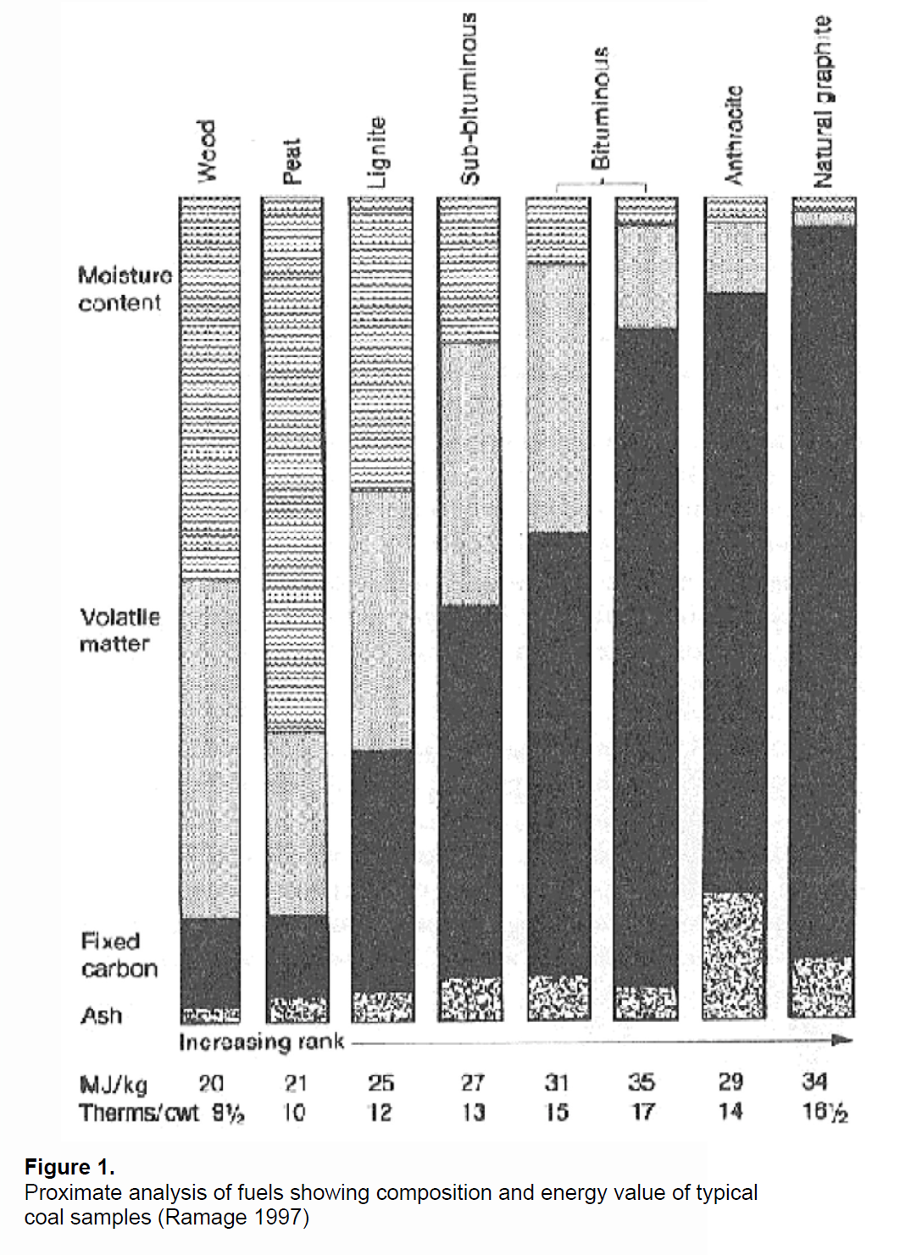

Slide 11
Peat, Natural graphite and Diamonds
Coal is formed from peat. Peat is dug out the ground, dried and then used as a fuel. It was used as a roofing material and today it is used in potting mixes
Natural graphite is part of the coal process.
It is not clear exactly how diamonds are formed. Some believe that diamonds are formed deep within the earths core, and bought to the surface by volcanic activity
Others believe that diamonds are the last part of the coalification process. Coal that is put under a huge amount of pressure and heat will eventually turn into diamonds

Slide 12
Coal measures and seams
Coal measures are a group of seams that are the same age.
The Northern or Newcastle Coal Measure is made up of twelve seam.
the Wallarah seam
the Great Northern seam
the Fassifern seam
the Upper Pilot seam
the Lower Pilot seam
the Australasian seam
the Burwood seam
the Nobbys seam
the Dirty seam
the Yard seam
the Borehole seam
the Sandgate seam

Slide 13
Geological Formations and Principal Collieries – Newcastle Region - 1951
httpwww.resources.nsw.gov.au__dataassetsimage001910

Slide 14
Coal measures
The Hunter Valley is made up of the various coal measures
Newcastle or Upper Coal Measure
Tomago, East Maitland or Middle Coal Measures
Greta or Lower Coal Measures
Dempsey Beds
Upper Marine Series
Lower Marine Series

Slide 15
Geological Formations and Principal Collieries – Upper hunter Region
httpwww.resources.nsw.gov.au__dataassetsimage001910

Slide 16
Geological sections showing coal seams
From the Coal Resources of NSW 1925

Slide 17
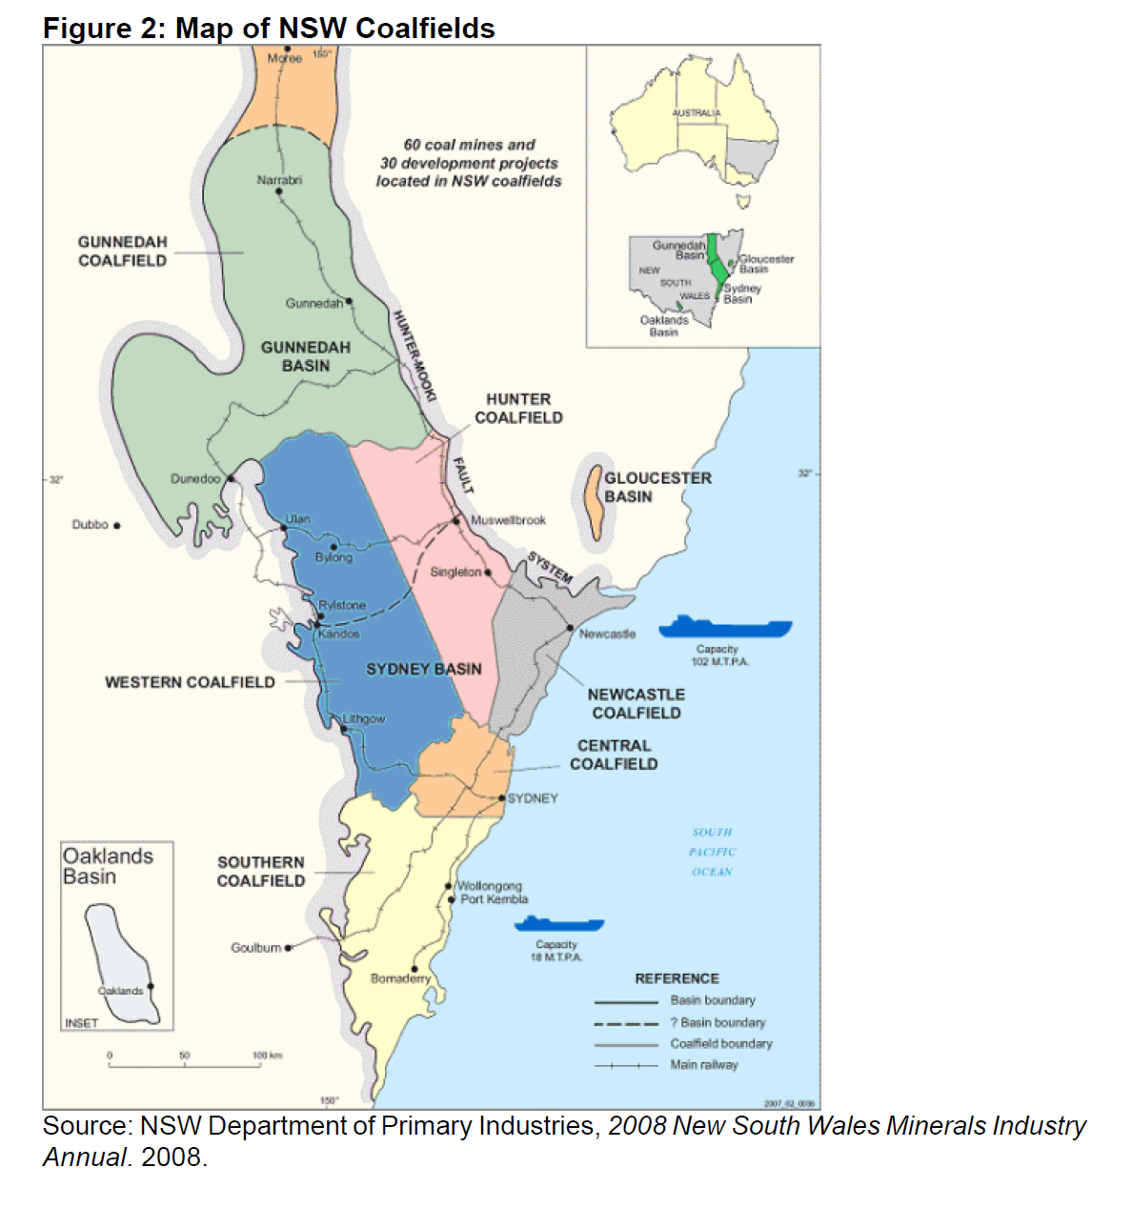

Slide 18
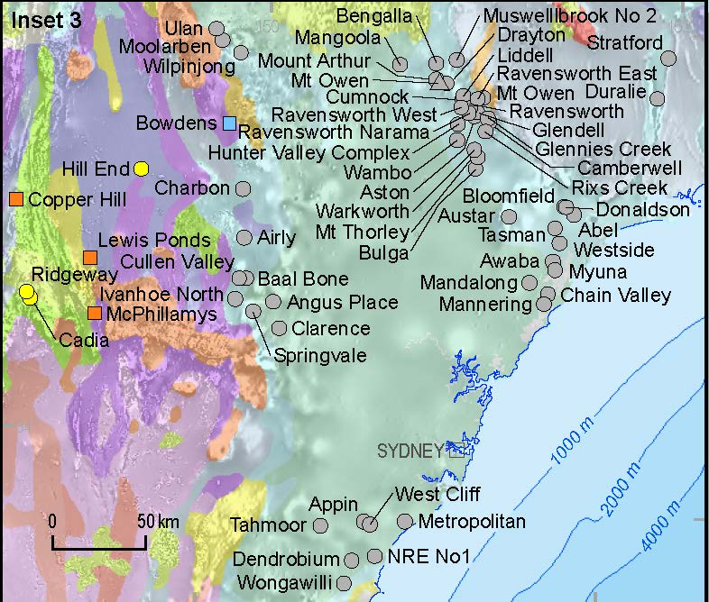
2011

Slide 19
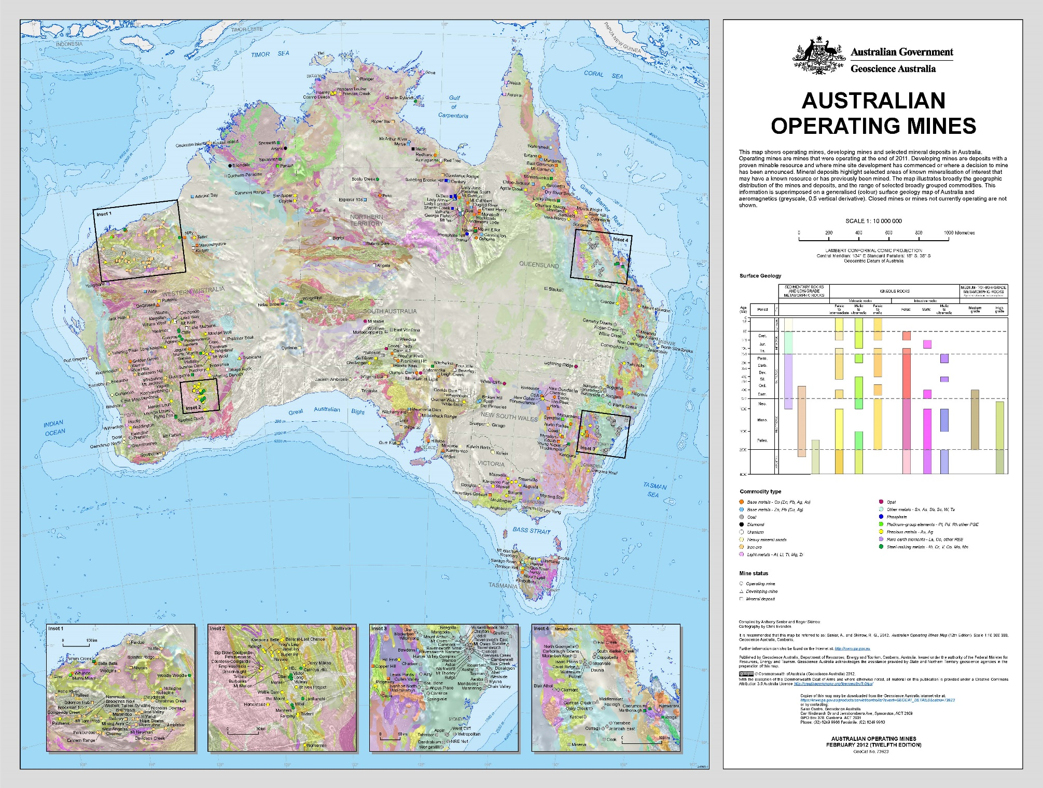

Slide 20
Proved Coal Reserves at the end of 2009

