Slide 1
Coal mining in the Hunter Valley
Educational Resource
People and Place I Coal and Community Project
Coal Mining in the Hunter Valley

Slide 2
Contents
How is coal mined
Underground mining
Open cut mining
Mine rehabilitation

Slide 3
hOw is coal mined in the Hunter Valley?
There are two main ways of mining coal in the Hunter Valley
Underground
Open cut
Underground mining methods can be split up into the following:
Bord and pillar
Short wall
Long wall

Slide 4
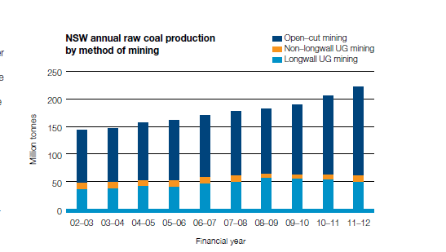
How does NSW mine coal

Slide 5
Underground mining Methods
There are two main methods of underground mining.
The bord and pillar method (extracts 50% to 60% of coal)
The bord and pillar method was used in the convicts mines, and was considered the latest method. It was introduced by convict miner John L Platt.
The long wall method (extracts 75% and over of coal.)
Methods
Images of Long wall Shearers

Slide 6
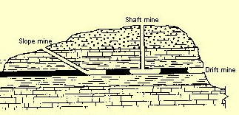
Types of underground mines

Slide 7
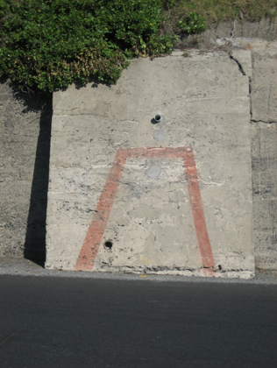
Underground Mining entrance
Drift entrance West Wallsend Colliery
Mine tunnel entrance at Fort Scratchely

Slide 8
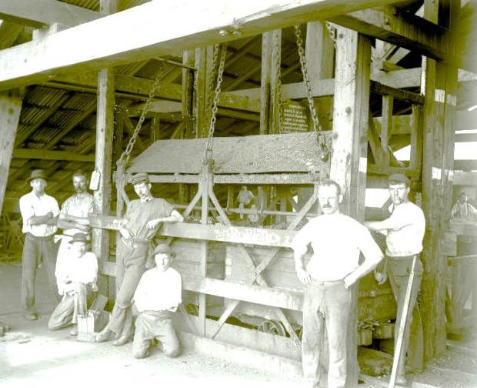
mine shaft
The first mine shaft in Newcastle was in 1817, where miners were lowered down in buckets
The elevator at the bottom of a coal mine
Coal waggons being brought to the surface via a shaft
A poppet head over a mine shaft

Slide 9
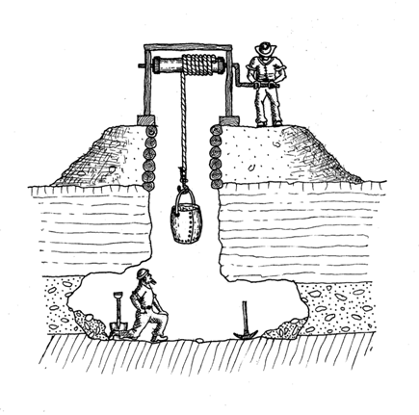
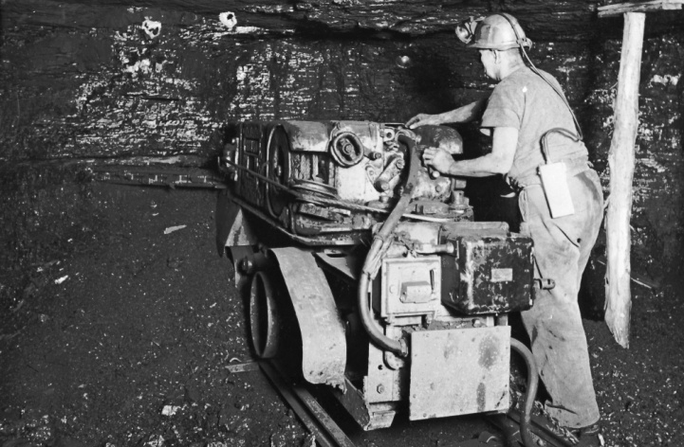
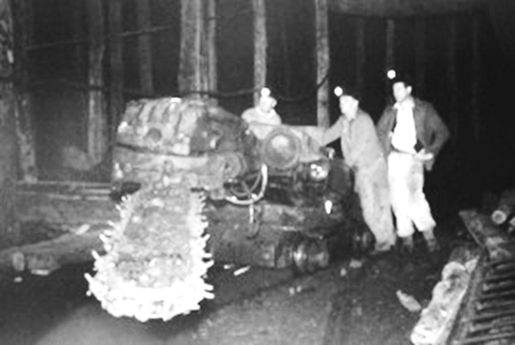
Technological changes
Convict miners used picks to undercut the coal face, using explosives to blast way the rest of the coal face.
Coal cutting machines replaced the picks to undercut the coal face. The first of these was used at Hetton Colliery in 1894

Slide 10
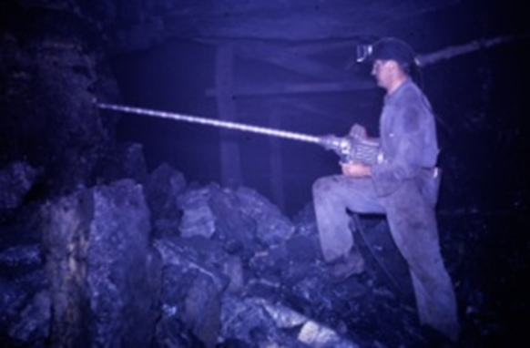
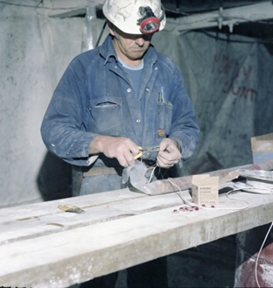
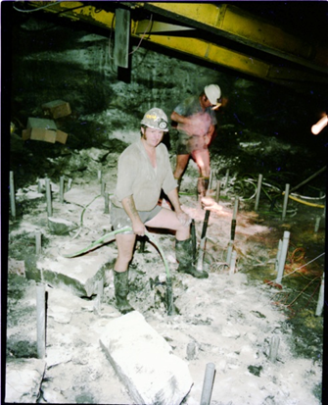
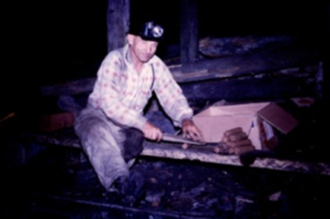
Drilling and Blasting
Drilling holes for the placing of explosives
Preparation of explosives, which were detonated by fuse, then electric detonators

Slide 11
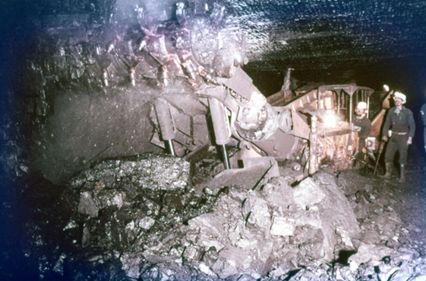
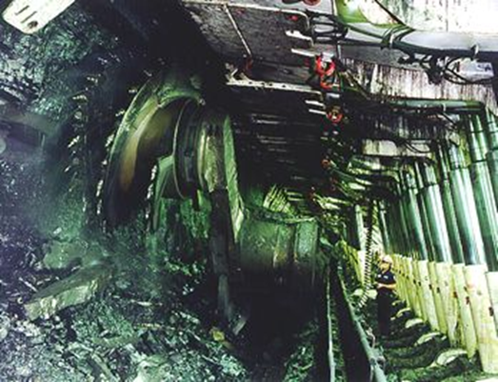
Continuous miners
Continuous miner
Long wall shearer with conveyor belt and hydraulic supports

Slide 12
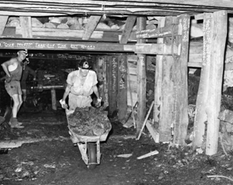
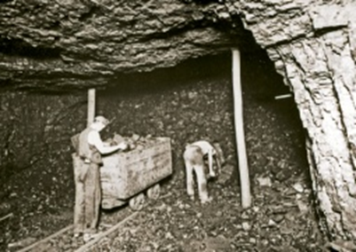
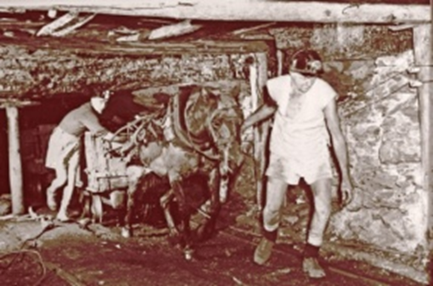
Traditional methods of removing coal from underground mines
Wheel barrows replaced baskets and both we used by convict miners.
Hand loading waggons
Pit horses were used before diesel, battery. and rope haulage was introduced.

Slide 13
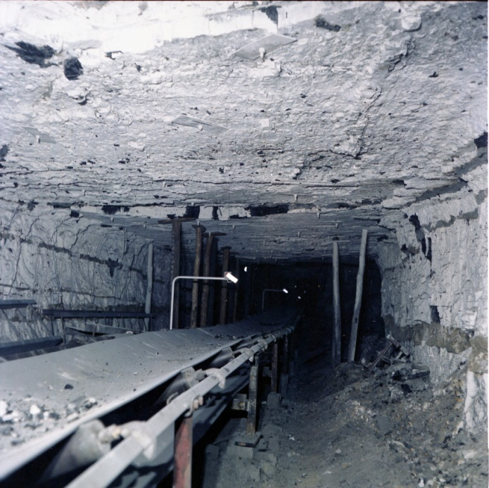
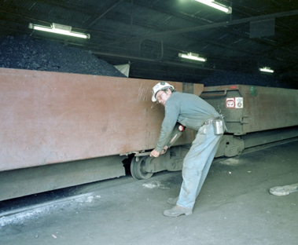
Modern underground transport for removing coal
Mine car at Stockringham Colliery
Conveyor belts have been used since about the 1950s particularly since the use of long wall mining.

Slide 14
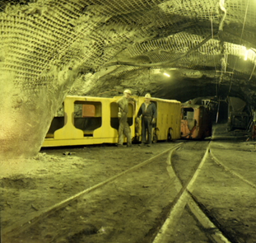
Transport for miners underground mine
As mining technology improved, the miners needed personnel carriers that were produced to transport the miners underground.

Slide 15
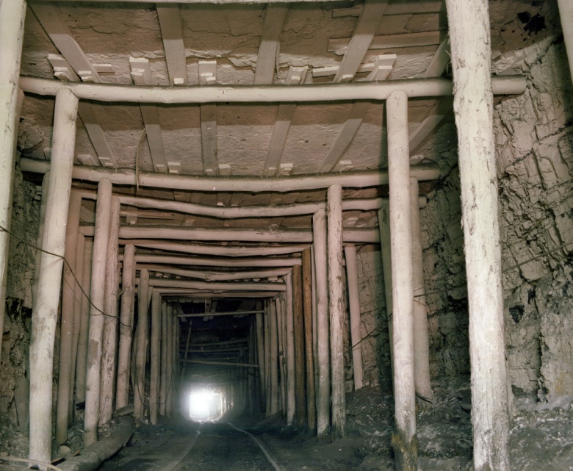
Roofing
Timber was used to secure the roof and walls. Timber supports were the main type of supports up until the introduction of the roof bolting systems.
Roof bolting was a new technology introduced to lessen the risk of rock falls. Different bolting systems were used:
Split and wedge anchors
Expansion shell anchors
Chemical anchors
Steel was used instead of timber in some instances

Slide 16
Open cut mining History
The first open-cut coal mine was the Commonwealth Coal Mine Number Two Lidsdale, Lithgow, NSW. It commenced operations on 30 November 1939.
In the 1940s the underground coal mines of the Cessnock region became less profitable. There was a shift from the traditional underground mine to open-cut. The first open-cut mine in this district in May 1944 was the Caldare open-cut mine, which was situated adjacent to the Aberdare Extended Colliery. Many above ground mines were converted into open-cut mines, including Bellbird, Neath and Wallsend Borehole Collieries.
Muswellbrook commenced underground mining operations in December 1944. In the early 1950s new mines were being established in Singleton to increase New South Wales coal production to up to 5000 tones per day.

Slide 17
Open cut mining Method
Open cut mines operate in areas where the coal is generally less than 50 meters deep. Mines do not exceed a depth of 120 meters
The top soil is removed and stored for rehabilitation purposes.
The overburden (or rock covering the seam) is removed by loosening it using explosions and removing it with draglines.
Coal is then dug out using a shovel or small excavators, and is loaded onto trucks or conveyor belts.
The coal then goes to a crushing plant, and then to a coal washery. Impurities are removed in the crushing plant and washery. These impurities are returned to the mine as part of the rehabilitation process.
The washed coal is moved by conveyor to stockpiles where it is then transported mainly to the power stations or the Port of Newcastle for export.

Slide 18
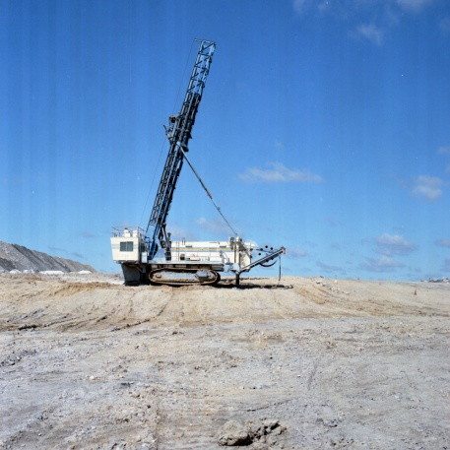
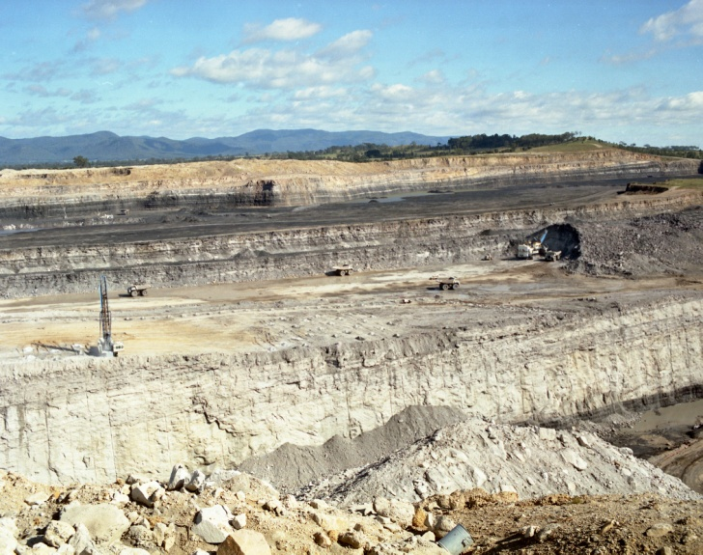
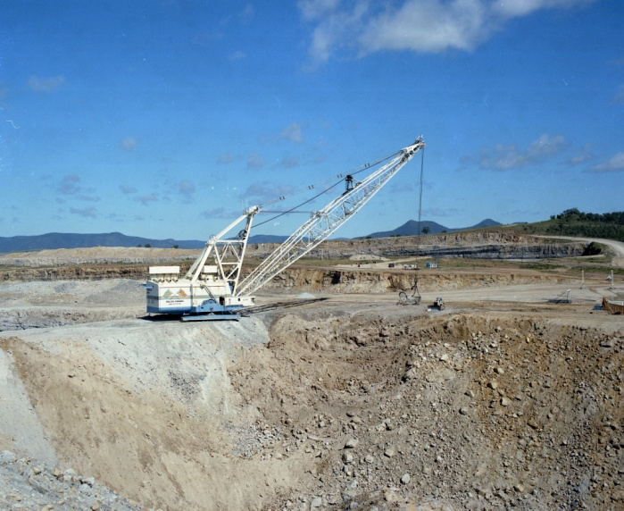
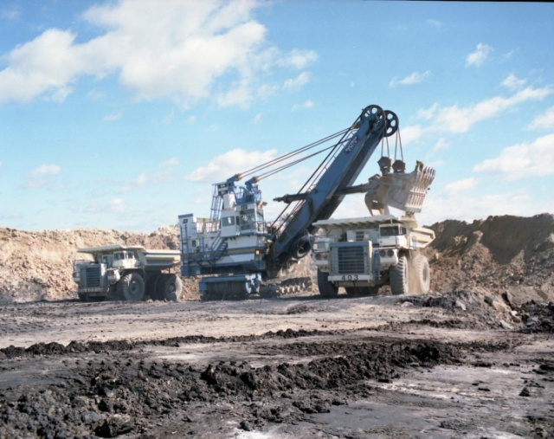
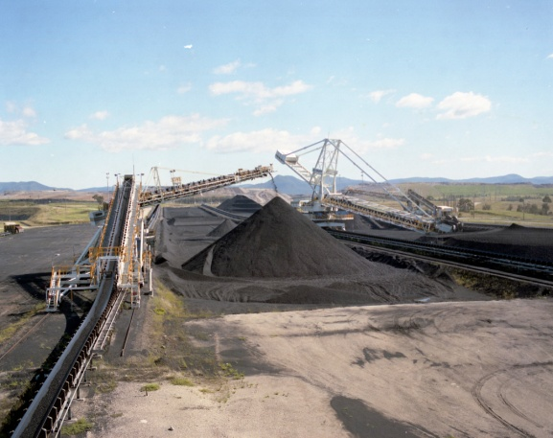
Drill
Mount Thorley Open Cut Mine
Dragline
Shovel or small excavator
Stockpile and reclaimer

Slide 19
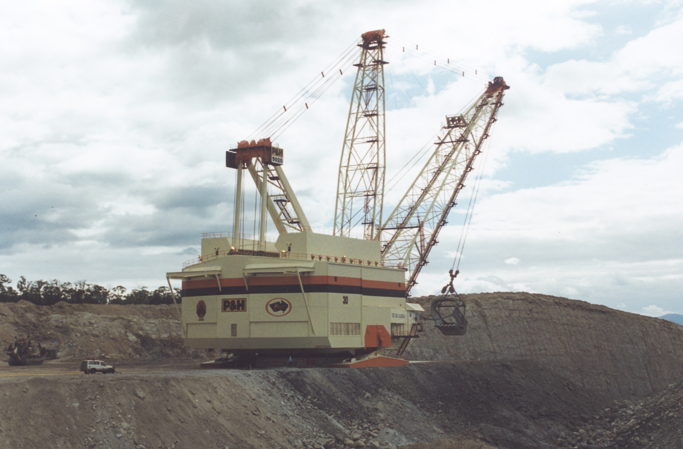
4 Wheel Drive
Miner
Open cut Drag line at Saxonvale Mine Hunter Valley NSW

Slide 20
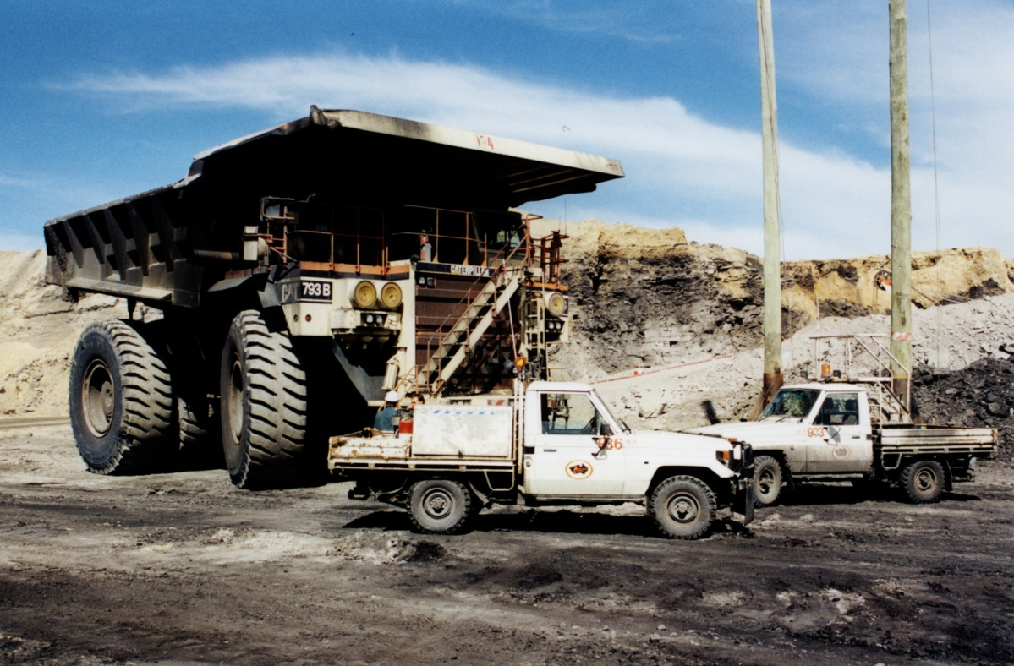
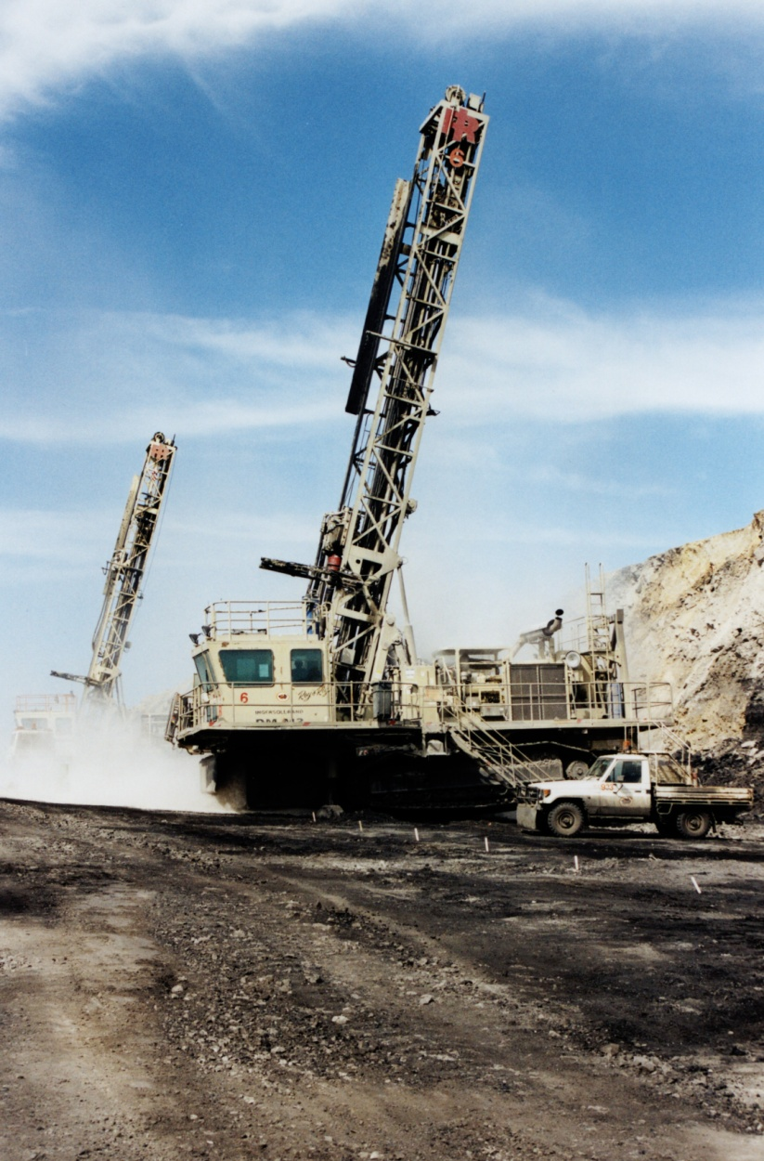
Open cut machinery at Saxonvale Mine Hunter Valley NSW

Slide 21
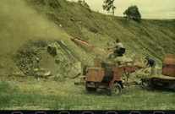
Rehabilitation
After mining the land is rehabilitated. The pits or voids are progressively filled with the waste material, re-contoured and replanted with vegetation suitable to its post mining use. The final void is often reconstructed to form a lake or dam.
Legislation requires coal mining companies to set aside funds to ensure old mine sites are rehabilitated. As at 2008 the NSW Government held 927 million dollars in Environmental securities.

Slide 22
The Buchanan Borehole Colliery

Slide 23
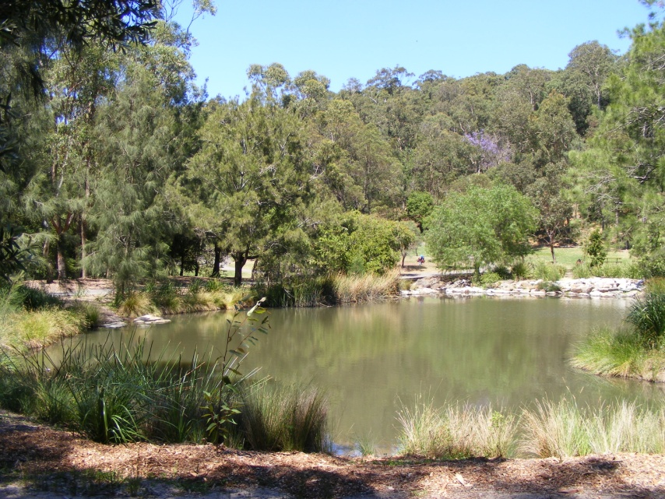
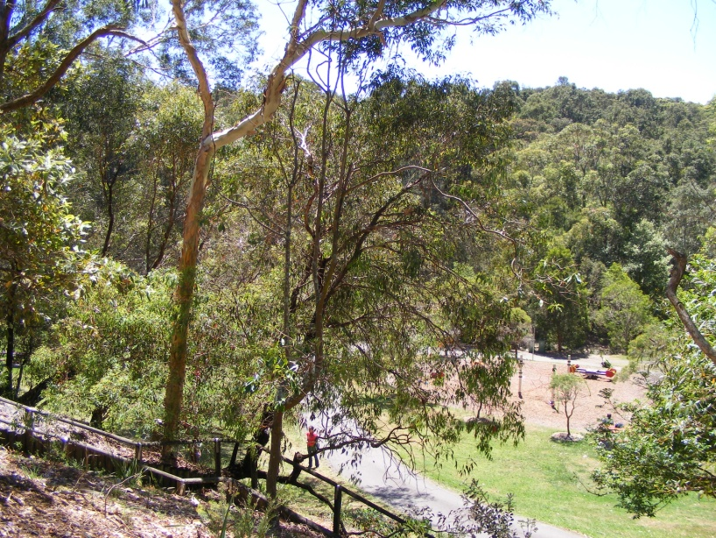
Mine rehabilitation Richley Reserve – Black Butt
Once Buchannan Borehole Colliery, few visitors to Blackbutt Reserve would realise this is a rehabilitated mine site

Slide 24
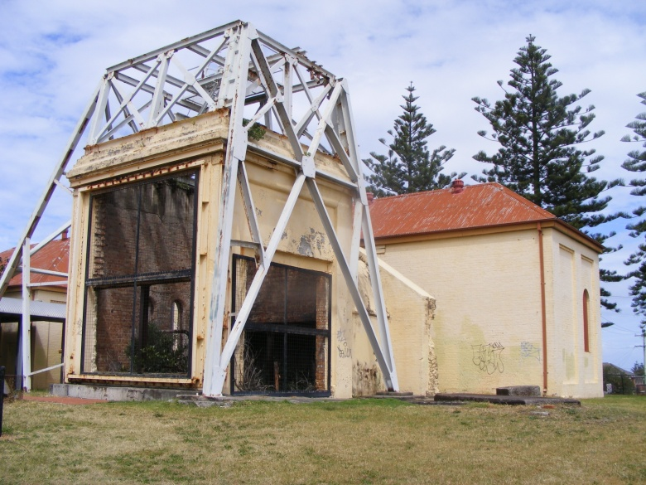
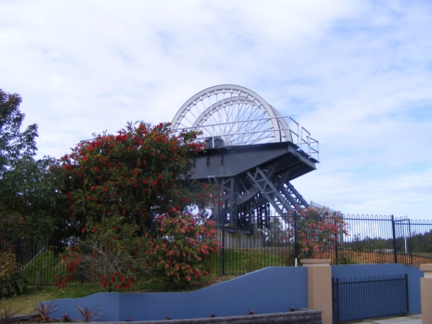
Mine rehabilitation John Darling – Lambton B
Lambton B Colliery is now a housing estate
John Darling Colliery is now Belmont Christian College

